Slide 1

GENESIS: A LEARNING PLATFORM
Presented by:
Devanshu Mahapatra(20104036)
Subhashish Mahapatra (20104049)
Athul Nair (20104048)
Nishank Jain (20104046)
Project Guide
Prof. Vishal Badgujar

Slide 2
CONTENTS
Introduction
Objectives
Scope
Features/ Functionality
Project Outcome
Technology Stack
Block Diagram

Slide 3
1. Introduction
The Project “Genesis” is developed in JAVA language. It mainly focuses on basic operations of an institute’s database information system. Like Inserting, Deleting, Editing information regarding students , faculty and the library.
Using this application, a user can get every information about an Institute’s database and download reference material.
The implementation of Genesis starts with integrating Library with College Management System and Student Database.
The application is tasked with entering and updating master records like Student and Faculty Details, Library Information and Downloading eBooks etc.
The records can be further managed by the user based on their access level.

Slide 4
2. Objectives
To provide a friendly environment to maintain the details of books and college infrastructure.
To maintain easy circulation system using computers and to provide automated reports rather than the traditional way.
To improve customer service through greater access to accurate information and user friendly GUI.
To increase efficiency of Academic Management.
To achieve greater accountability and transparency in operations.

Slide 5
3.Scope
Can be applied in Coaching Institutes, Industries, Colleges, Schools etc.
Useful for the students, faculty and the administration

Slide 6
4. Features/ functionality
Log in/ Apply Now/ Forget password
Log in and Apply now helps user to register and login themselves which gives a security to the user by preventing unauthorized actions and thus protects the data. If user Forget password they able to change password.
Home Screen
Combo boxes are added to the dashboard which makes it easier for the user to select the branch, department and course through which they can view or edit the data according to their convince.
3. The user of the system are
Admin
Faculty
Students
The software provides excellent graphical interface for the user through which they can perform various tasks such as create, update and view details.
The user should be a part of the institute where this software is being implemented.

Slide 7
5. Project Outcomes
User will be able to login & Signup if in case user forget their password then they can change their password too.
User will be able to access the Homepage.
User will be able to maintain the records of students, Faculty and Library based on their access level
Records of every student, faculty and books issues in library are available with their scanned copy. The E books can be downloaded in .zip format
Only Registered Users can view the data and download books while only the admin and faculty members can edit the details . Thus providing protection to the data.

Slide 8
6.
Technology Stack
Hardware Requirements: -
Hard Drive: 20 Gb or more
RAM: 200 Mb and above
Processor: Intel i3 and above, M1 and above
Software Requirements: -
Operating System: Windows 7 and above , MacOS X and above
Database: MySQL JDBC Connector
Server: MySQL Community Server
Language: Java (16.0.1)
Framework: Java Framework
Development Tools: Eclipse IDE

Slide 9
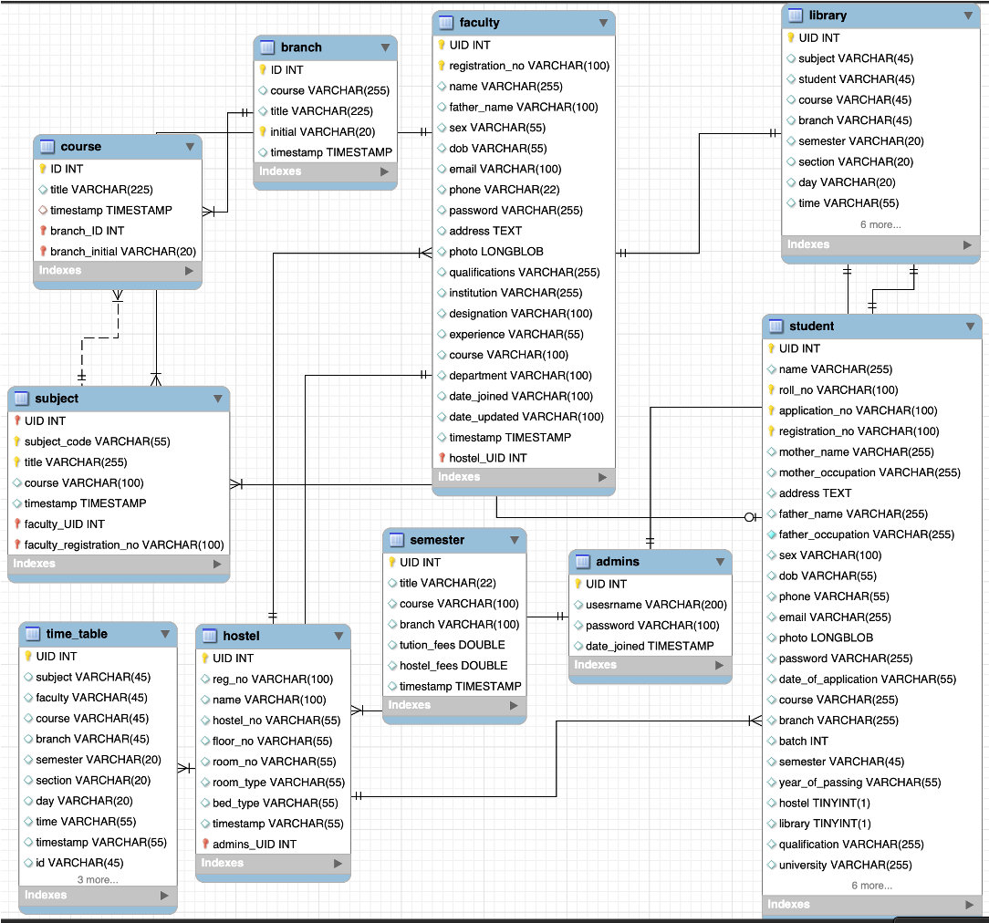
7. Block Diagram

Slide 10
THANK YOU

